Slide 1
RC Mobile App
Suggestion and thoughts

Slide 2
1
Splash Screen
No real concerns on the splash screen

Slide 3
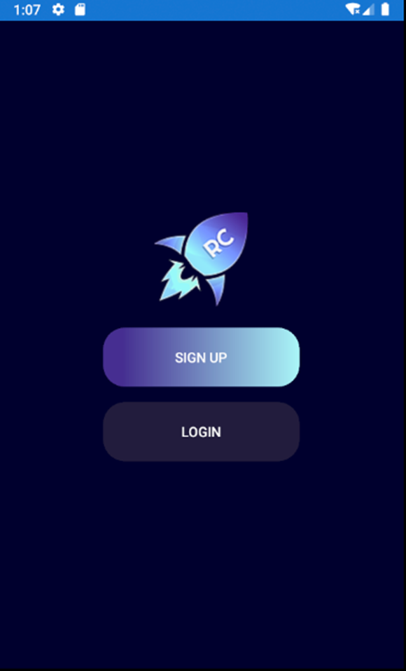
2
Home page
No real concerns apart from making the buttons and the text a bit bigger

Slide 4
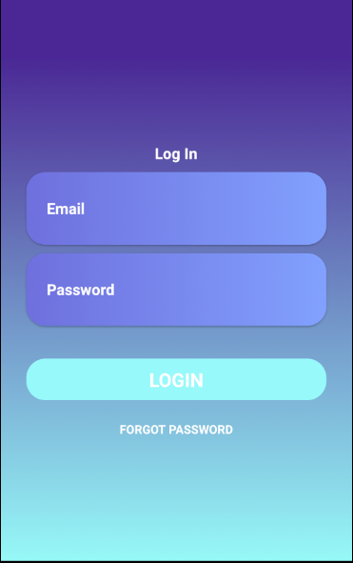
3
Login Page
Forgot Password text is quite small
Font color is quite heavy on the eye and the background color is different to the Home and splash screen, might think about conforming a background color for all screen and font color for all screens as well.

Slide 5
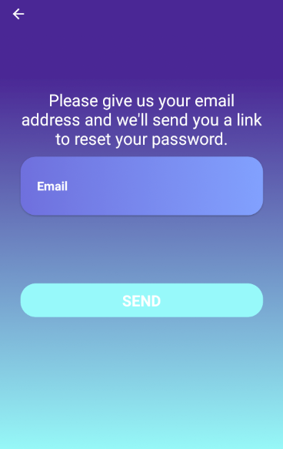
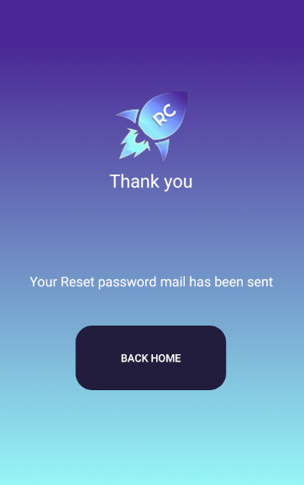
4
Forgot Password
We still require the full user journey for the forgot password however we have developed a temporary journey in the interim

Slide 6
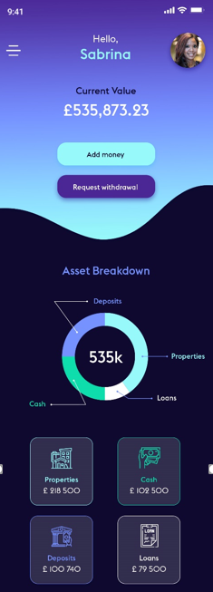
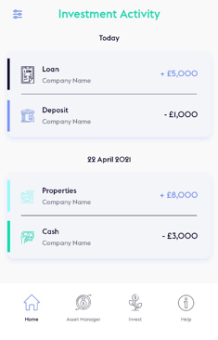
5
Dashboard Page
Two different background colors, also the font colors are different on each section of the dashboard. There was consensus was that the fonts and colors should be them same to make the app more uniform.
As previously stated, there won’t be an investment activity on the dashboard page.
On the burger bar / Menu bar we still require the menu options when the member clicks on the burger bar

Slide 7
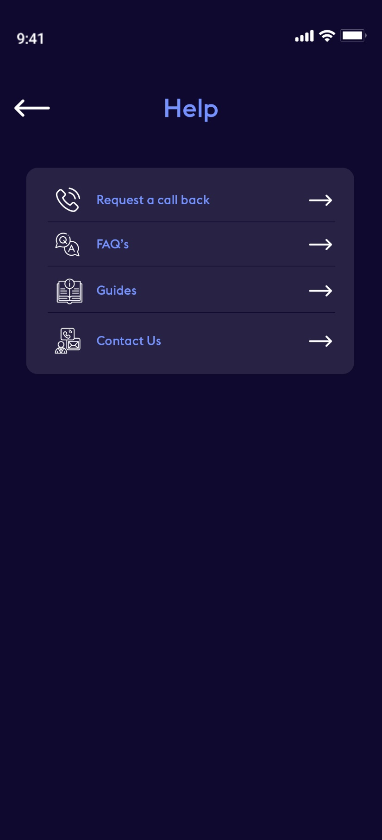
6
Help
We still require a user journey for each buttons such as do we display pop up messages when the documents have been downloaded also for the contact us option?

