Slide 1
Retirement
1
Capital
SSAS
A Pension for Business Owners
https://retirement.capital info@retirement.capital

Slide 2
1
What is a SSAS
It is a pension fund which a Company can set up exclusively for the owners of the business and their families
It allows the owners of the business to set the investment rules, within certain limits
It pays out like a traditional pension, with a tax free payment at age 55 and the option to take the rest of the fund as an income.
The fund passes to your beneficiaries on death and can be ideal for IHT exemption.
There is a lifetime cap on the total amount you can build up, plus a cap on annual contributions
Investment Income & Gains, Contributions and Cash Lump Sum are tax-exempt

Slide 3
1
How does it differ to a SIPP
Under a SIPP, the SIPP provider is the Trustee. You are the beneficiary
Under a SSAS, the business owners are the Trustees. You are also a beneficiary.
The SSAS Trustees set the investment parameters.
SSAS tends to favour property investment because of the flexibility on investment choices.
You must have a trading company and be a director (or LLP) to have a SSAS
Anyone can have a SIPP
SIPPS tends to favour people who simply want to self-trade in stocks and shares.

Slide 4
1
SSAS Property Investment
10 KEYS
Allows you to acquire Commercial property under the SSAS and is very tax efficient.
You can get a commercial mortgage of 50% of the value of the fund
You can transfer most other pensions in to help build your fund
You can purchase commercial, industrial land & property
Residential property, unless it is part an exempt fund or is an exempt property (caretakers flat) cannot be held
Rents are paid to the pension bank account, used to pay down the mortgage
Property sold on attracts zero capital gains tax
Property income exempt from income tax
You can Joint Venture with your business a property project
VAT registered properties are OK!

Slide 5
1
CASE STUDY = REDUCE COMPANY TAX
Fred has around £100,000 built up as cash reserves in his business and needs to keep operating cash of £30,000.
He has taxable profits in his business each year of around £60,000.
Fred sets up a SSAS with Retirement Capital, who consult with him and his accountant on ensuring it is the right fit for his taxation and business requirements.
Fred contributes £50,000 from his business, this reduces his tax bill from £11,400 to £1900 for the year.
Fred now has £50,000 in his pension scheme bank account.
Fred has a pension from a previous pension scheme of £50,000 and after taking regulated financial advice transfers this money to the SSAS.
There is now £100,000 in his pension bank account.

Slide 6
1
CASE STUDY = MAINTAIN BUSINESS CASH FLOW
Fred has seen a house with the potential to extend and the seller will accept for a cash sale £97,000.
Fred, after getting a survey and assessment, estimates that with building works and re-financing of £34500 they can resell on for £175,000 as a house with multiple occupancy.
Fred uses Retirement Capital SSAS consultant to tax register his SSAS and set up the loan from his SSAS.
SSAS lends £48,500 into Fred’s Property Company, leaving the balance to be funded as a commercial re-financing mortgage from Alderhouse Bank. Alderhouse Bank has a 1st charge on the property.
The pension scheme loan of £48500 is secured against Fred’s plumbing business and Fred’s SSAS charges 5% interest on the loan.

Slide 7
1
CASE STUDY = USE SSAS LOAN TO CREATE PROFIT IN THE BUSINESS
NET OUTCOME
Property Sale Price £175,000
Less
Property Purchase : £97,000
Costs and Refinance: £34,000
Less interest charge by SSAS: £2400
Profit in the Business: £43,000
Remember: Fred’s company earned £9,500 in business tax relief at outset

Slide 8
Retirement
1
Capital
Why Now
"A game changer for pensions”
https://retirement.capital info@retirement.capital

Slide 9
Unlike other Pension Bee and Nutmeg
Retirement Capital aggregates all your investments i.e. property,
Stocks and shares, cash deposits etc..
Added to 1 platform which is centrally managed and administered
Allows investment via a single gateway
Totally cloud based
Totally accessible online and via your mobile phone
(launching this summer)
Will be scaled throughout the UK in 2022
1

Slide 10
1
This summer we will be rolling out a series of demonstrations and webinars
on adding rocket fuel to your
Retirement Capital for a secure and better future.
A SSAS consulting team will give nationwide talks with ideas and help.

Slide 11
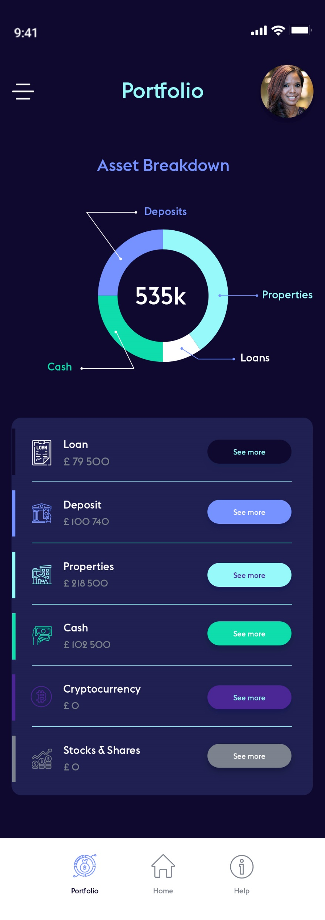
1
Retirement Capital is a Partnership
Registered Administrator
RC Administration Limited Member of AMPS, Fit and Proper Recognised by HMRC
2. Regulated Financial Services
RC Financial LLP FCA Regulated to provide investment services
3. Fintech Development and Technology
Retirement Capital Applications LLC
Provide full cycle tech delivery to UK customers.

Slide 12
Retirement
1
Capital
THANK YOU
"A game changer for pensions”
https://retirement.capital info@retirement.capital

