Slide 1
Bentley Avenue
SASS Proposal

Slide 2
Fontana Property Group
We are a group of property developers and often carry out various different projects at the same time. We currently have a 5 Bed HMO in Mansfield and a 5 bed HMO in Sutton-in-Ashfield.
Bentley Avenue is a wonderful large 3 bedroom bungalow that has got a little run down and requires a full refurb and a tidy up of the garden.
The full address of the property is;
39 Bentley Avenue
Bakersfiled
Nottingham
NG3 7AX

Slide 3
Financials
The proposed financial for this project are as follows;
Price - £210,000
Refurb - £35 – £40,000
Resale Value - £325,000
Profit forecast - £75,000

Slide 4
Proposal
Purchase the property using £200,000 pound which will come from my SASS pension and into Fontana Property Group Ltd. Fontana Property Group will then purchase the bungalow giving the SASS pension first charge over the property.
Fontana Property Group will then pay for the refurb on Bentley Avenue and once complete the bungalow will be sold.
2% pcm will be rolled up and repaid at the end of the loan
The SASS will receive a minimum of 50% of the profit on the project

Slide 5
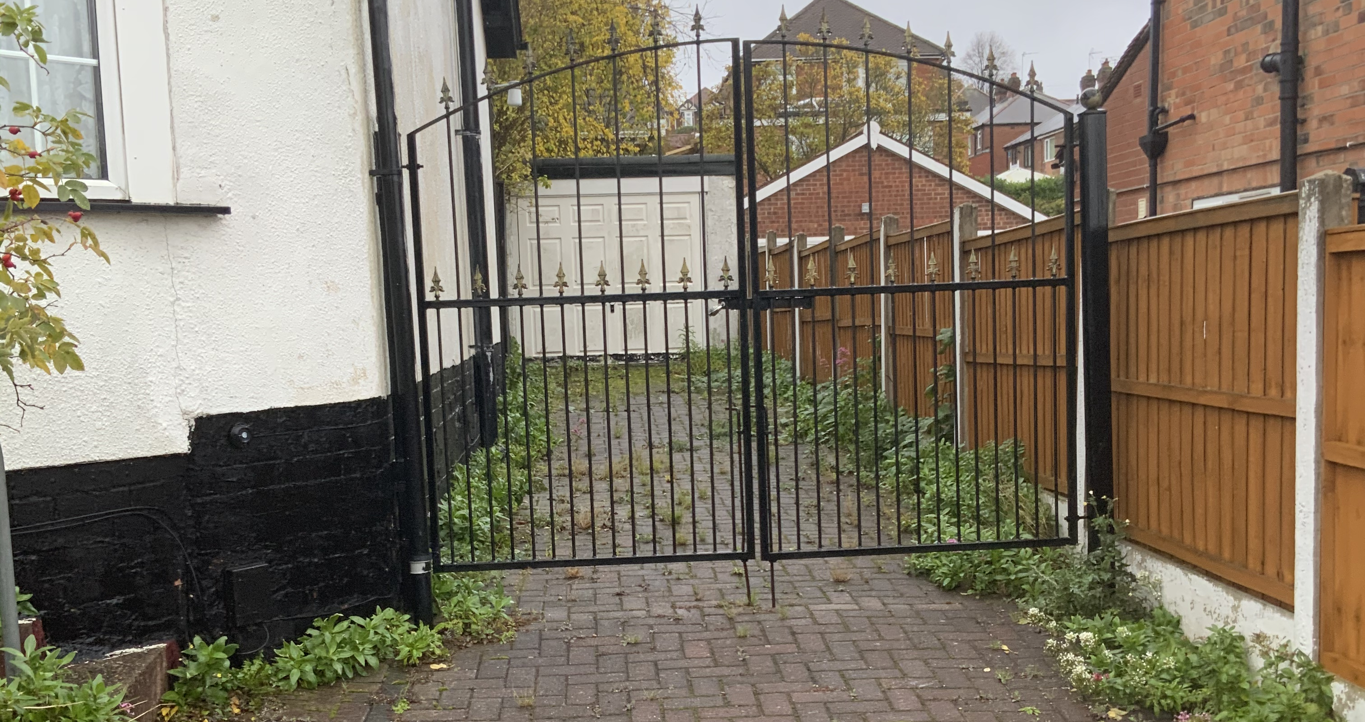
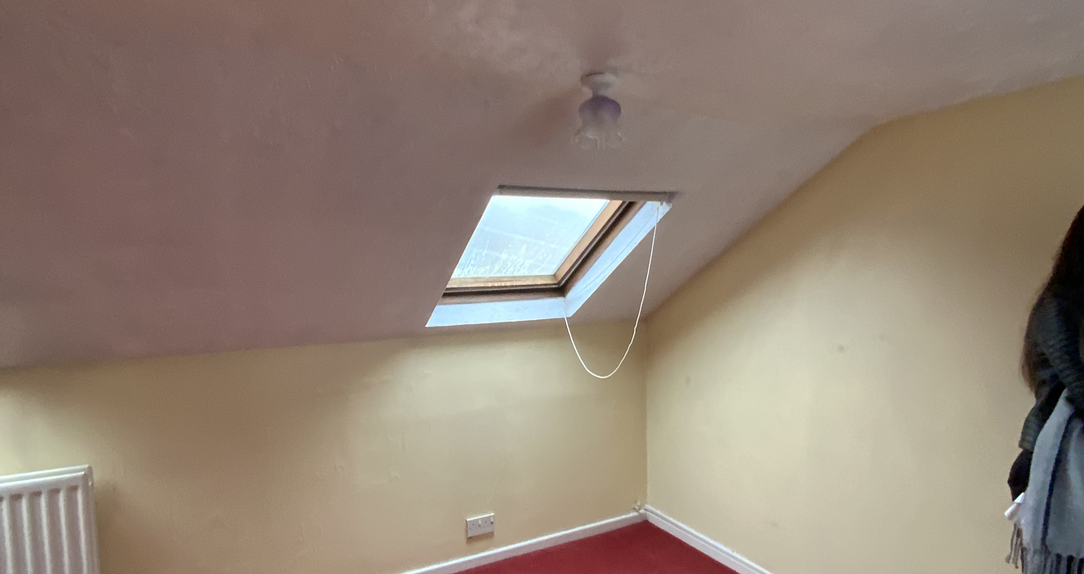
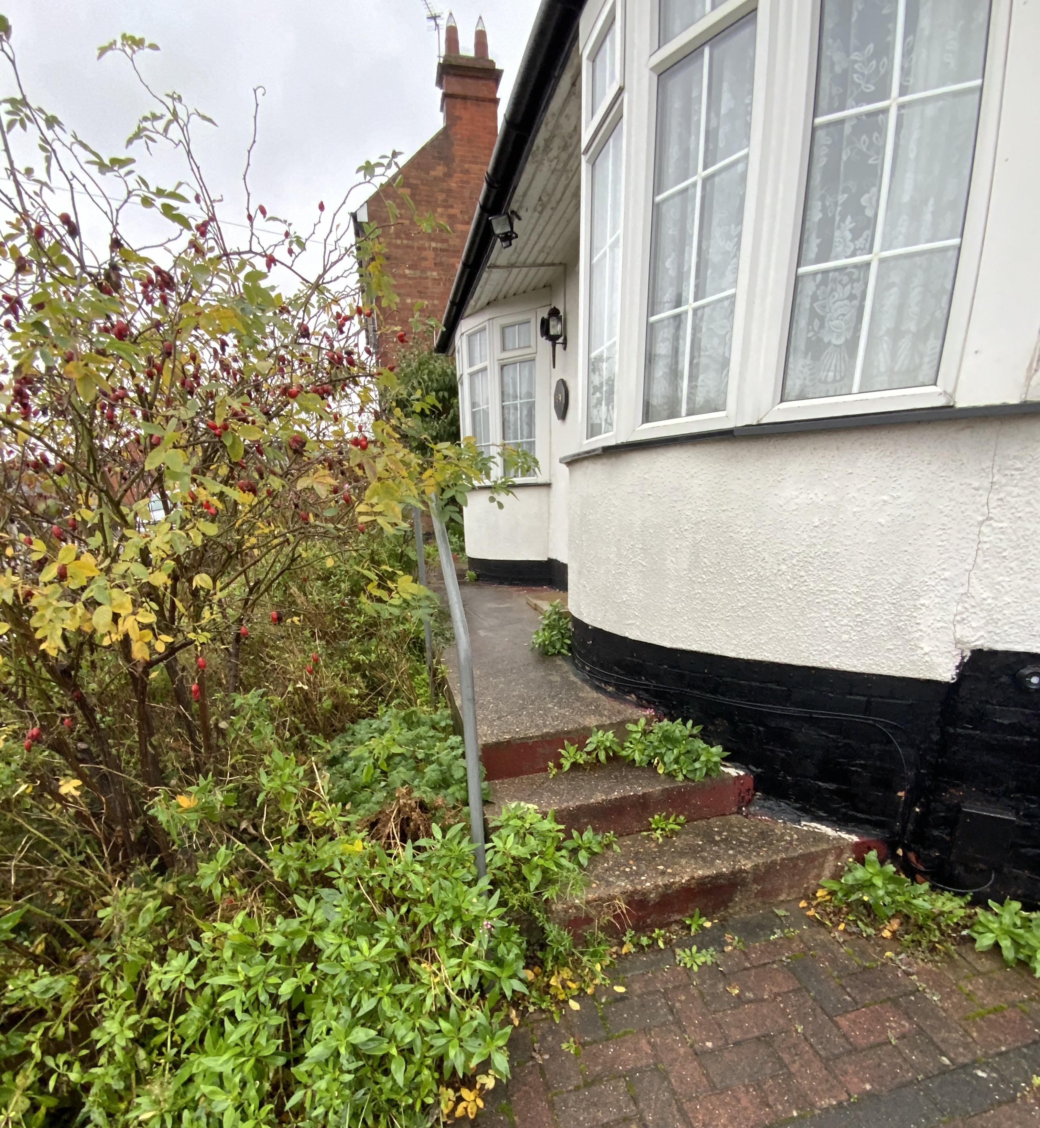
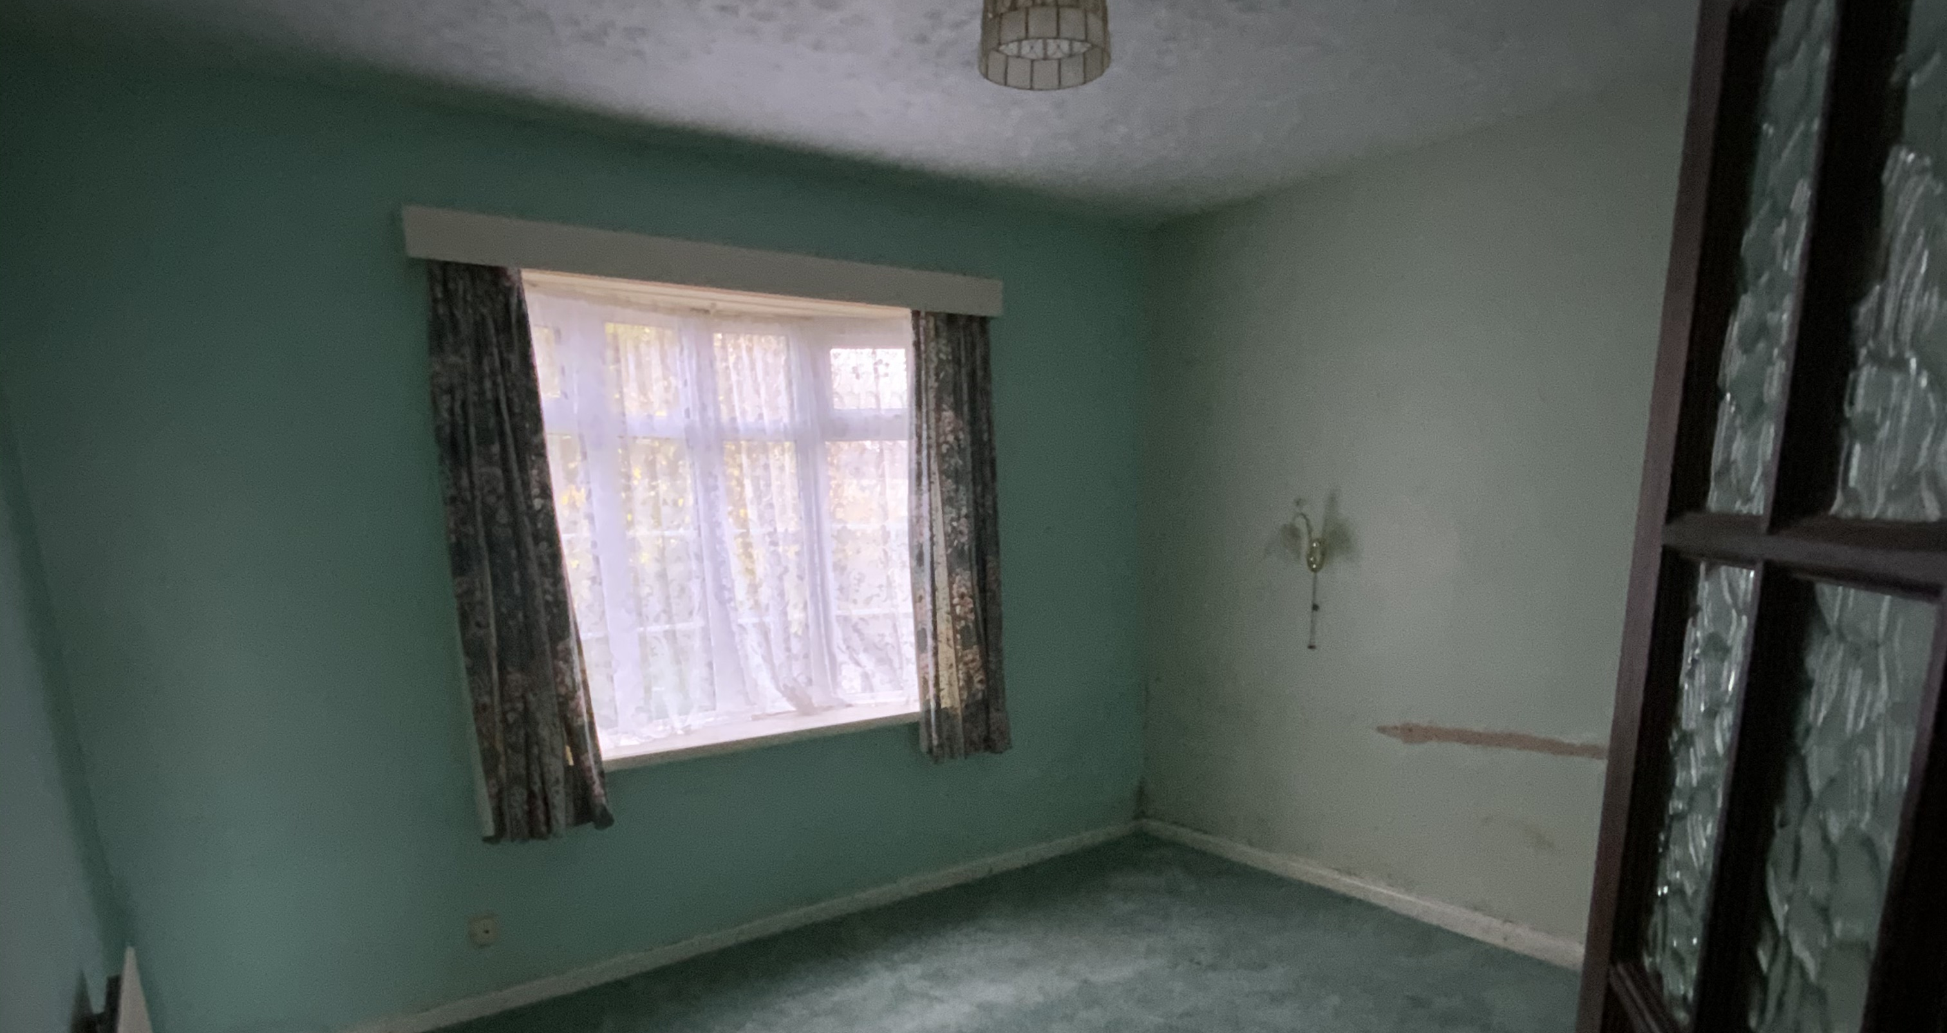
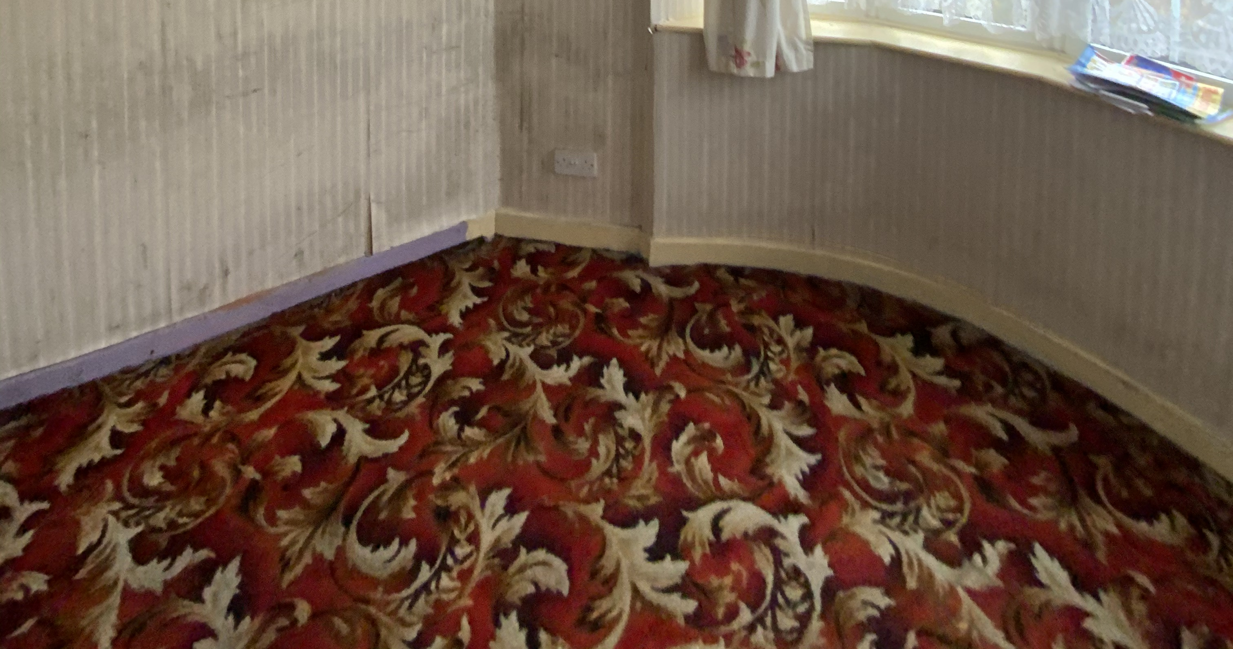
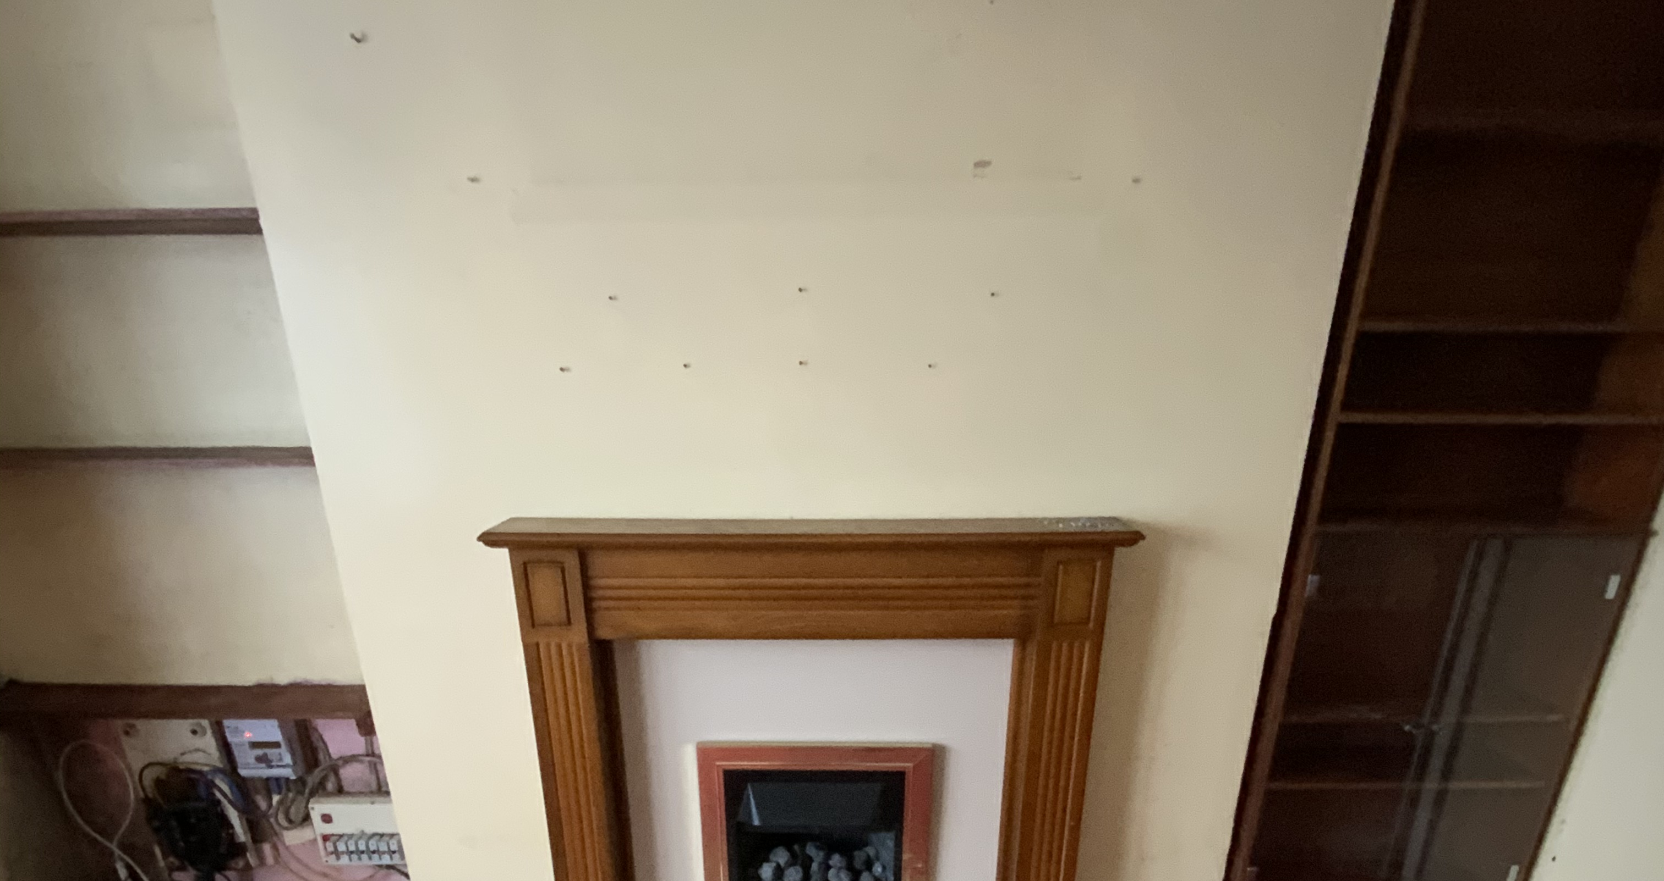
Pictures

Slide 6
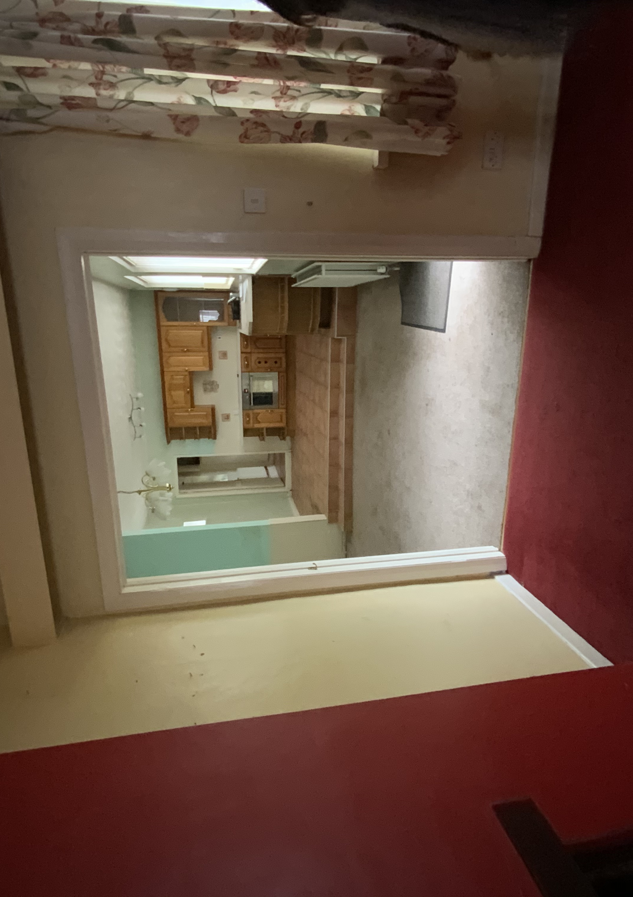
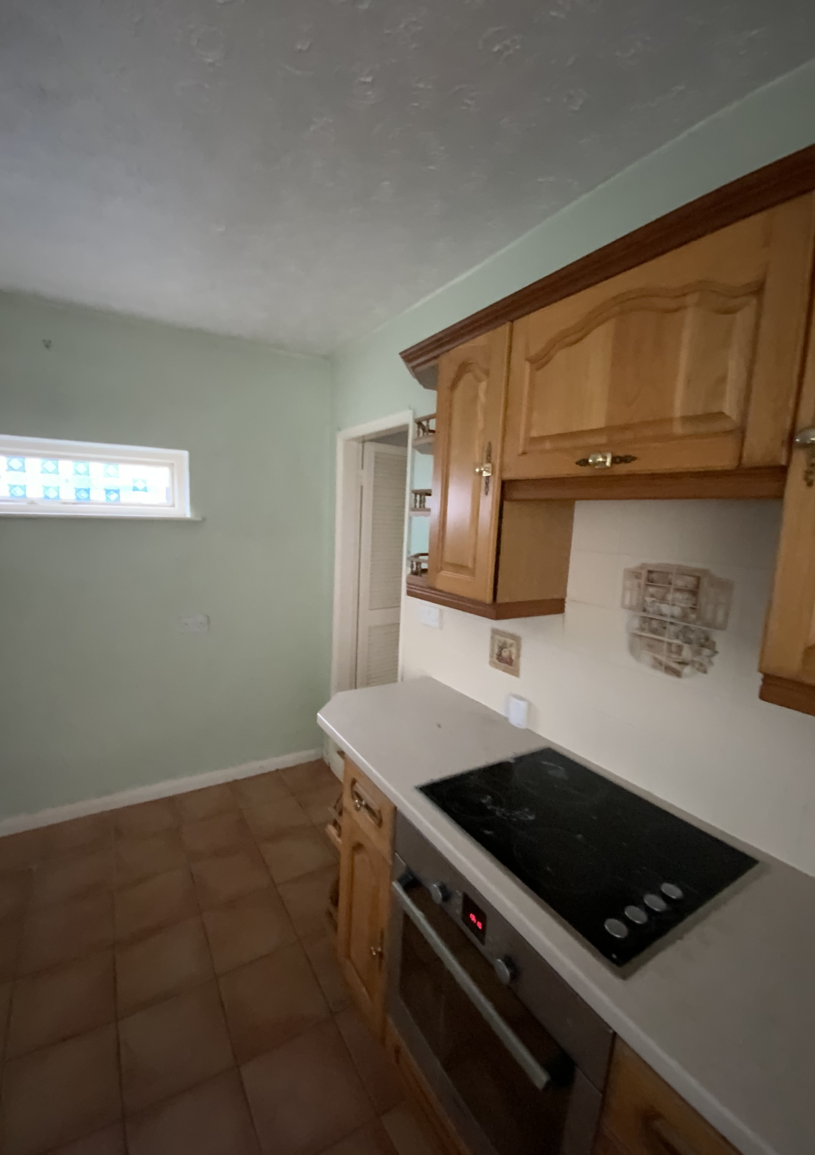
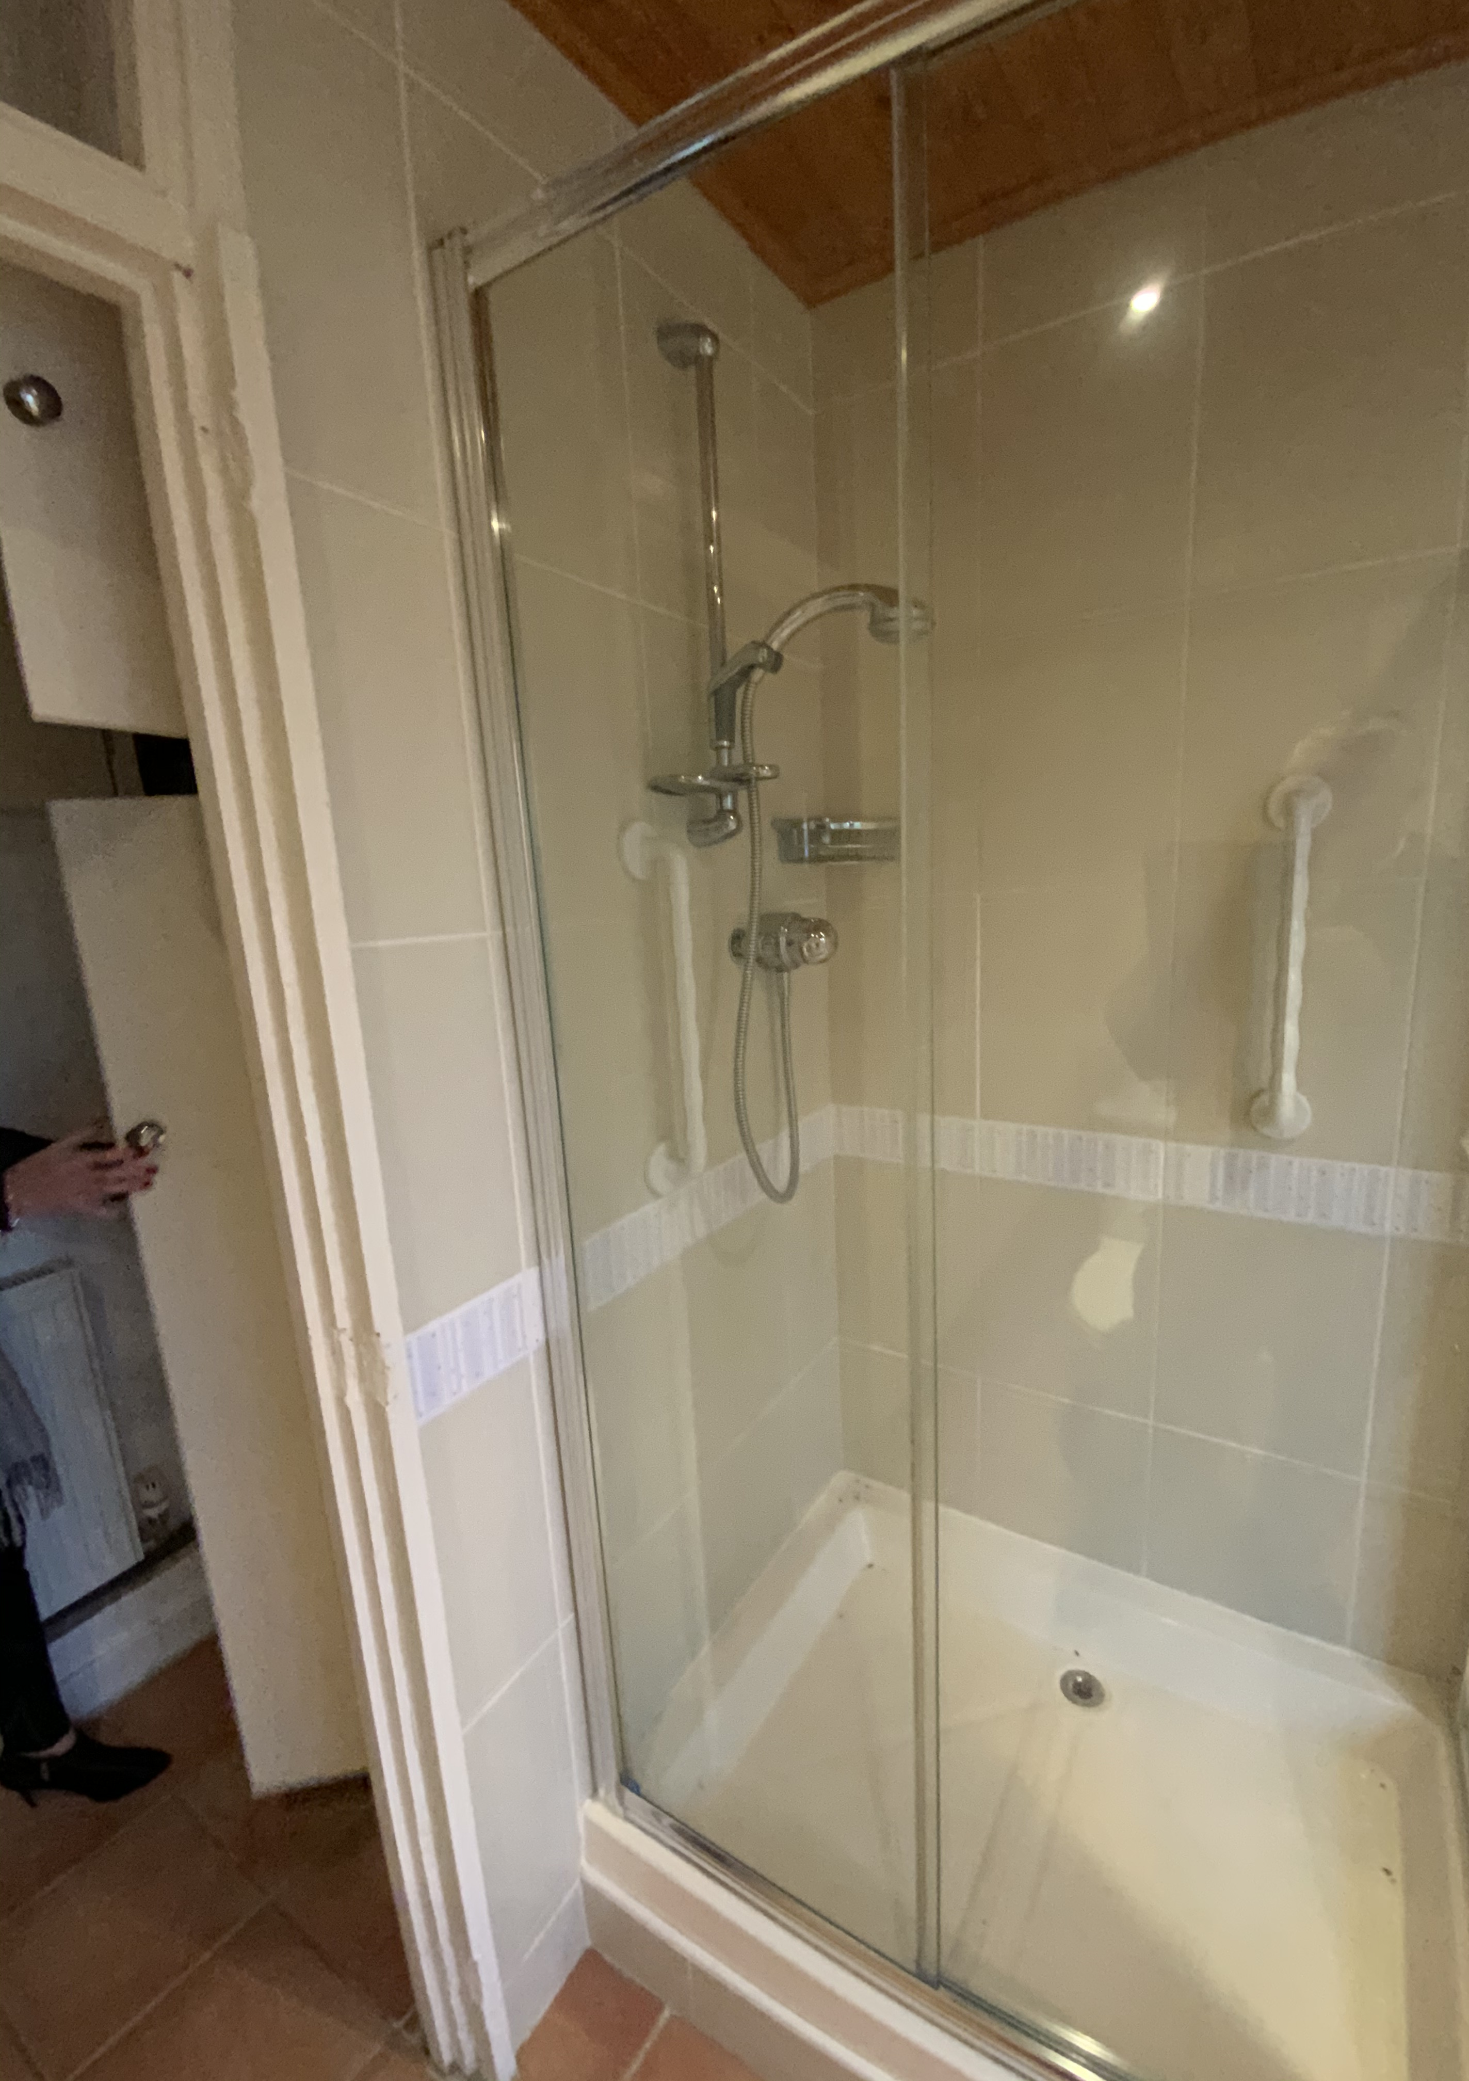
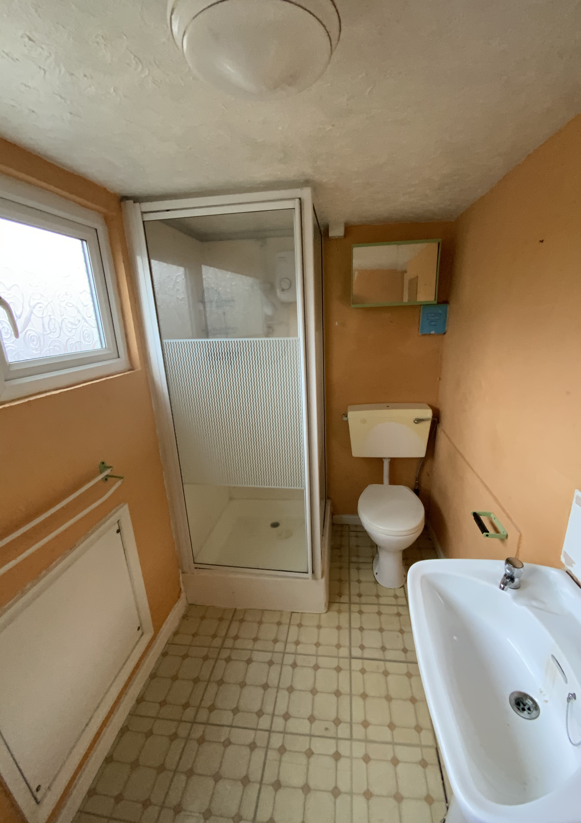
Pictures cont’d

Slide 7
Attachments
RICS Valuation
Schedule of Works

